Slide 1
Debugging
If debugging is the process of removing software bugs, then programming must be the process of putting them in

Slide 2
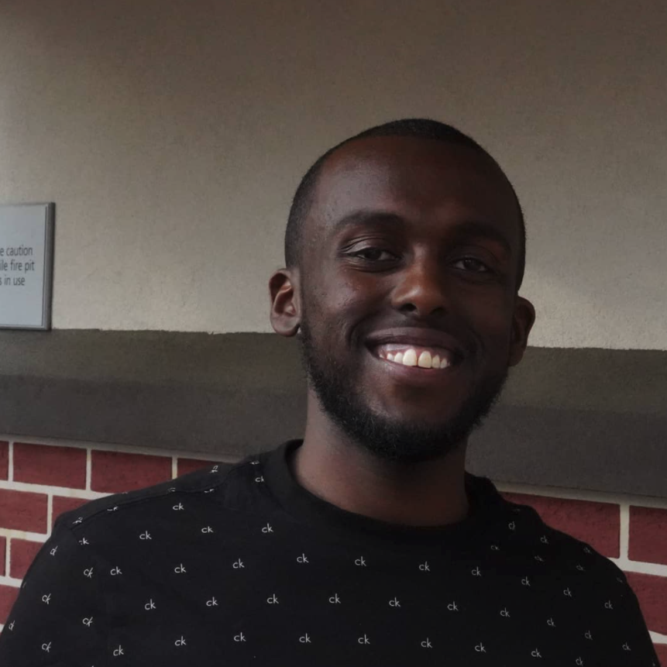
About me
‘2018 UMASS BOSTON B.S In CS
‘2018 Hack diversity alumni
Worked for 3 companies as a SD
Employed with netjets
I love video games and playing ball

Slide 3

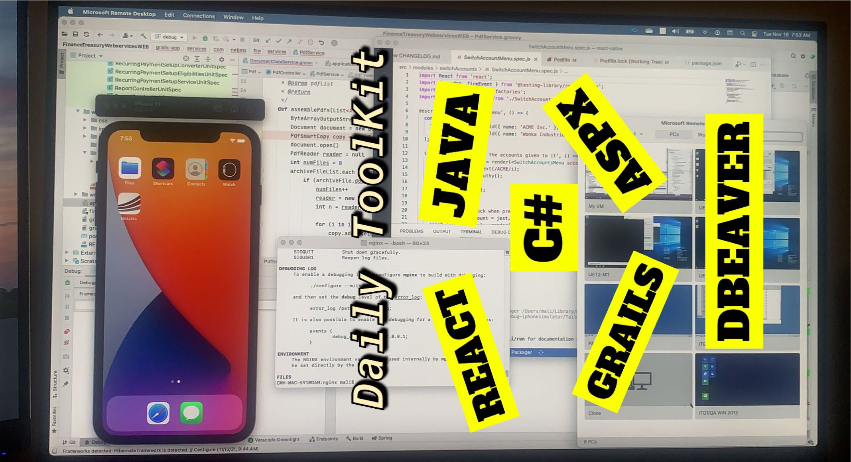
Current position: Software Developer/Analyst

Slide 4
What is debugging
Debugging is the routine process of locating and removing bugs, errors or abnormalities from programs.
Complex programs have bugs, errors, and or abnormalities
Debugger is a software tool to help test & debug code

Slide 5
Why do we debug?
the programs we write as software developers don’t always do what we expected it to do
Some code bases contain 50k+ lines of code
We need a tool to see what is going on inside the code
Debugging allows us to stop and start runtime code

Slide 6
DebUgging terminologies
Breakpoint: is a point in the program where the code will stop executing
Call Stack: stores information about the active subroutines of a computer program (How the code flows)
Step over: Go to next line
Step into: Go into function/method
Step out: Go outside of function/method
Watches VARIABLES YOU ARE WATCHING FOR CHANGE

Slide 7
My Experience as a software developer
80% of my time spent researching
Trying to understand fully Problem context
Debug code to understand context
Fix and test

Slide 8
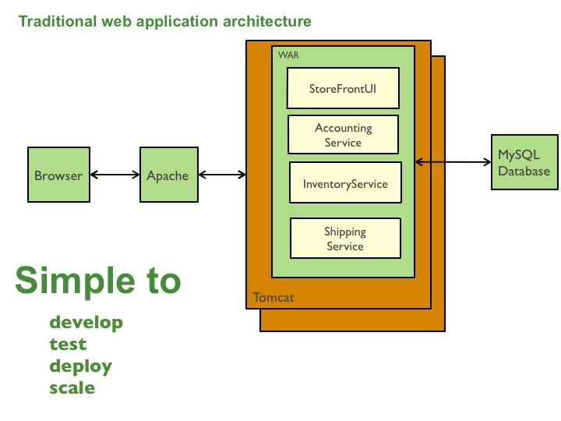
Example 1: Monolithic applications
Enterprise applications are HUGE
Trying to find a bug is like finding a needle in a haystack
In this example the program runs through multiple packages
By debugging you follow code execution (Skipping all unnecessary code)

Slide 9
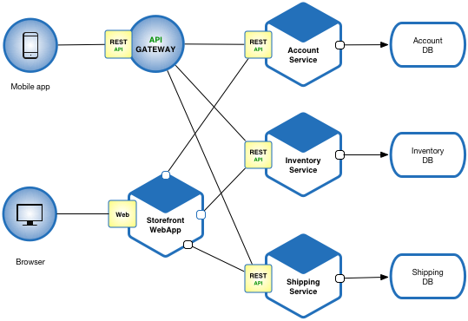
Example 2: Microservice Architecture
Microservices are tiny but many
The graph shows how each is coupled to the other
In this example programs are dependent on each another
Debugging allows you to follow your code from program to program

Slide 10
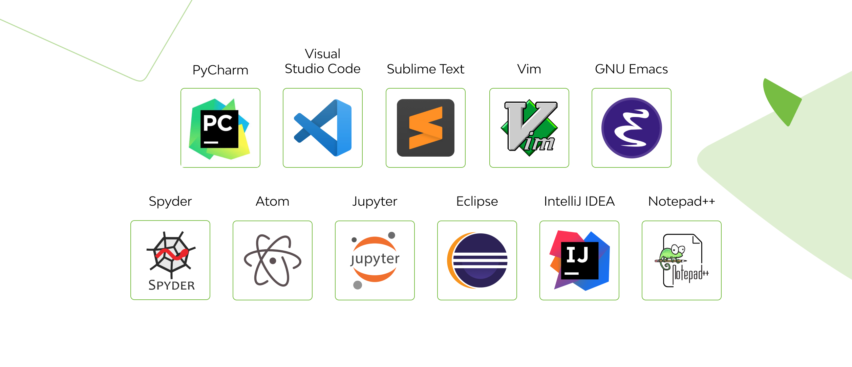
Debugging tools
Debugging exists for all languages
Most IDEs have some form of debugging capability
Different languages have different ways to enter debug mode
Different ides are better suited for different languages

Slide 11
Our Focus for this lab:
Introduction to debugging
Work through example stories each pertaining to a bug or feature request
Groovy Grails backend, and a react frontend
Full-stack developer

Slide 12
Introduction to debugging
Debug python code
Step breakpoints
Learn to step over, step into, and step out
Call stack and variables

Slide 13
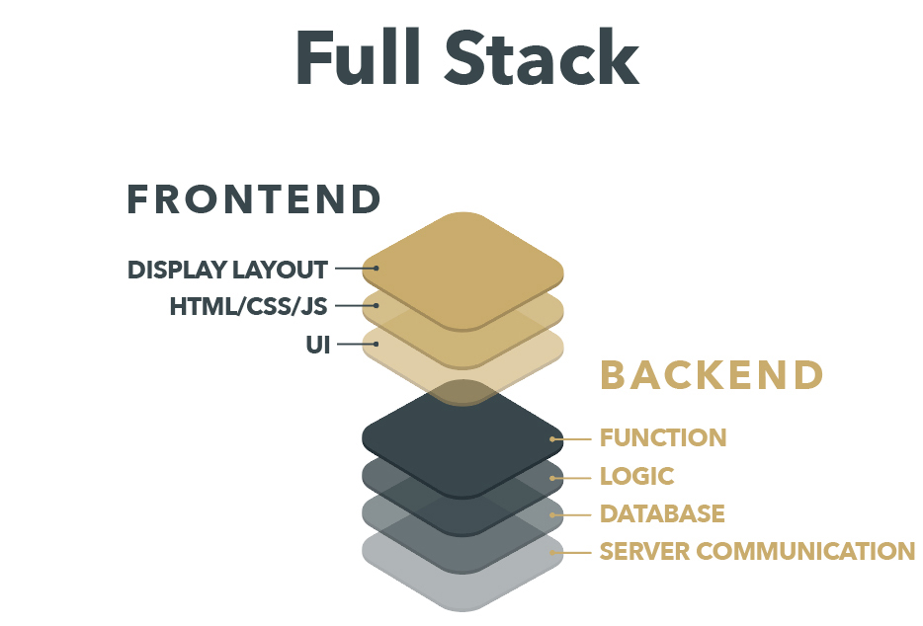

Slide 14
RAPM-1052: owner cannot book A flight (*3)
Description: After logging in, an owner cannot book a flight. Their flight order is correct, but the system is not processing their flight request
Given:
From: Boston To: LA
Date: 01/04/2022
Passengers: any
Acceptance Criteria:
Owner clicks book
The Flight Request gets sent to our systems
200 Status OK Returned
Flight is in booked state

Slide 15
RAPM-1053: flight center is no longer able to search flights by date
Description: Since release cadence R2022.6: flight center is no longer able to search flights by date.
Given:
StartDate: 01/2022
EndDate: 04/2022
Acceptance Criteria:
Given a start and end Date
All Flights within that date range should return
200 Status OK Returned

Slide 16
Conclusion
Programming is like solving a puzzle
Debugger shows you how the pieces fit together

